Slide 1
Legal compliance

Slide 2
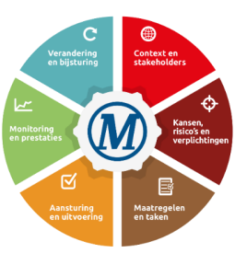
Governance, Risk & Compliance
Identify & Assess obligations: Context, legislation, specific legal obligations, (Nogepa) standards, legislational changes, Winstershall policies.
Risks and changes: Manage obligations with targeted tasks, deadlines, registrations and alerts.
Prevent and mitigate: Relate ‘risks and opportunity’ analyzes to legislation and regulations. (including stakeholder analyses, RI&E, Risk assessments etc).
Control: Procedures, Instructions, Training and Tasks (Maximo).
Operational control and monitoring: monitor the implementation progress of Winstershall’s objectives and reports results on this progress.
Audit: LEARN and DEVELOP.
What can’t be measured, can’t be managed.

Slide 3
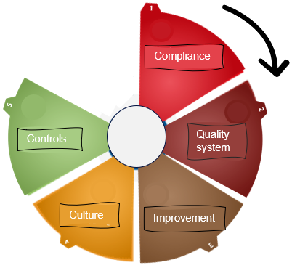
Compliance to effective Control
Compliance: Driven by legislation, checking and inspections.
Quality system: Consistent delivery every day. Driven by desired outcome.
Improvement: improvement in systems and outcomes. Driven by desire to get better.
Culture: what happens when no one is looking? Driven by team dynamcics.
Effective controls: Risk managed. Status known. Driven by need to get it right.

Slide 4
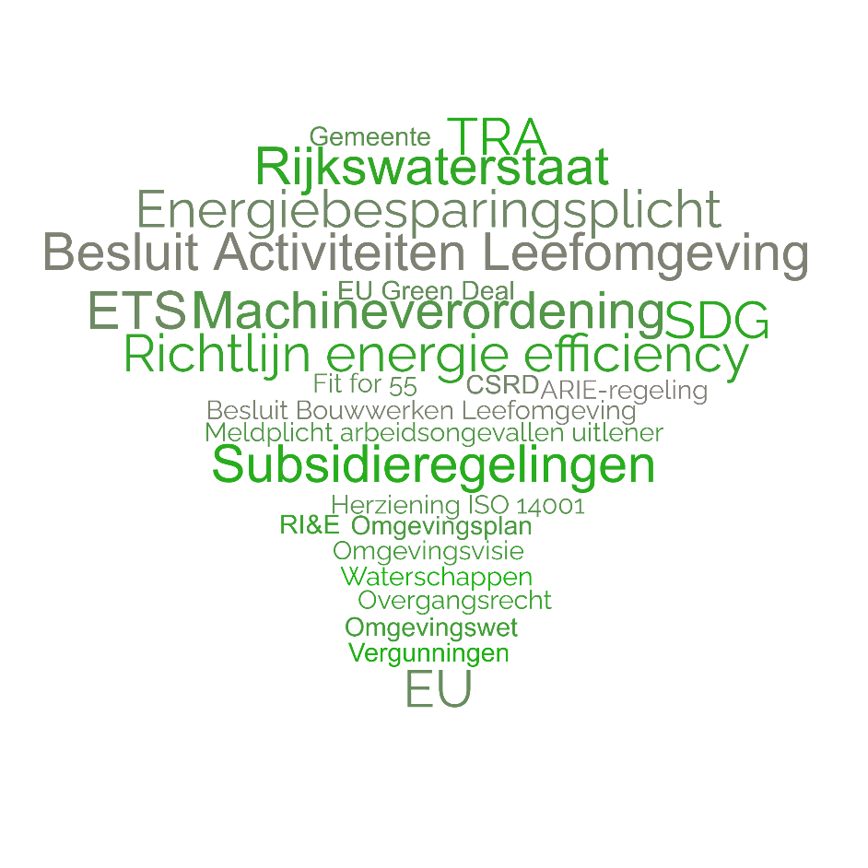

Message: Forecast
Increase in regulatory pressure and obligation to be in control/
social expectations/sustainability
2050
2030
NOW

